Slide 1

Event Management Service Coordination System
A microservice-based architecture for automated event planning and team coordination.
Presented by: Naresh Nagula

Slide 2


Problem Statement
Managing events involves complex coordination between multiple teams (Catering, Logistics, Decor). Manual processes often lead to:
Communication Gaps: Instructions are lost in emails or calls.
Missed Deadlines: Lack of automated reminders causes delays.
Critical Coordination Failures
Reactive Management: Issues are identified too late to fix efficiently.
Limited Visibility: Managers lack a real-time view of progress.

Slide 3






Proposed Solution
Centralized Platform
Automation
Proactive Alerts
A unified interface for creating events, managing guest lists, and assigning specific tasks to service teams.
Automated workflow that distributes tasks, sets deadlines, and triggers reminders without manual intervention.
Real-time issue escalation ensuring the event manager is notified immediately if any team reports a delay.

Slide 4
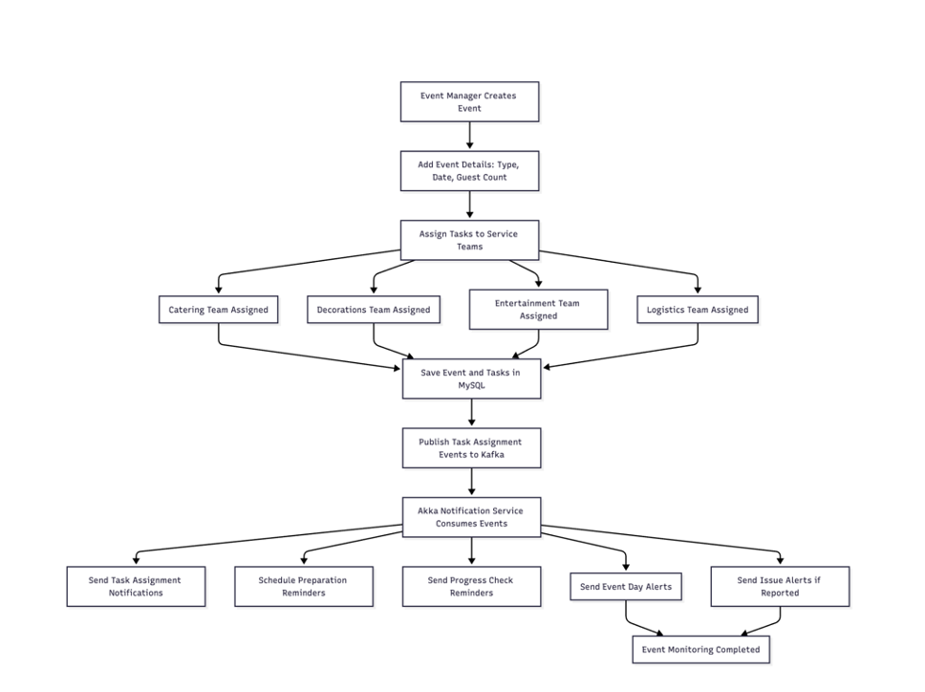

System Architecture
The system is built on a robust Microservices Architecture to ensure scalability and reliability.
Frontend: Manager Interface for control.
API Layer (Play): Handles RESTful requests.
Service Layer: Core business logic.
Messaging (Kafka): Async communication.
Notification (Akka): Alert management.
Storage (MySQL): Data persistence.

Slide 5


Key Components
Event Service
Notification Service
Kafka Broker
Manages event lifecycles, team assignments, and task tracking. Exposes REST APIs for the frontend application.
Powered by Akka Actors. Consumes events to schedule preparation reminders and send real-time issue alerts.
Decouples services to ensure that alerts are never lost, even if the notification service is temporarily busy.

Slide 6
System Workflow
1. Define
2. Process
3. Publish
4. Notify
5. Track
Manager creates event & assigns teams.
Service validates & stores data.
Task event pushed to Kafka topic.
Akka sends emails to vendors.
Real-time status updates.

Slide 7
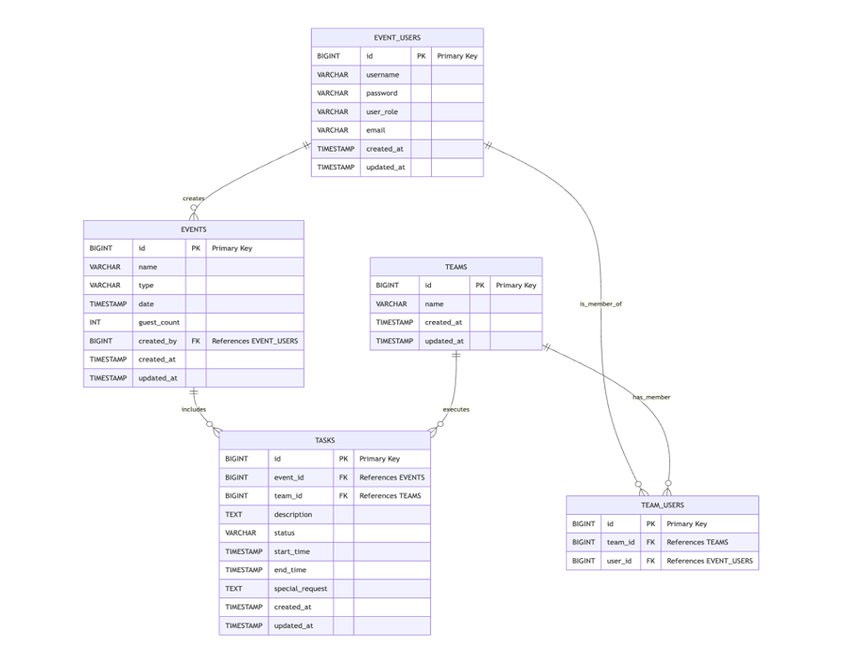

Database Design
Relational Schema
Optimized 3NF schema design for data integrity.
Events: Stores type, date, and guest count.
Users: Role-based access (Manager, Team).
Tasks: Links specific teams to events with deadlines.
Notifications: Logs of all sent alerts.

Slide 8
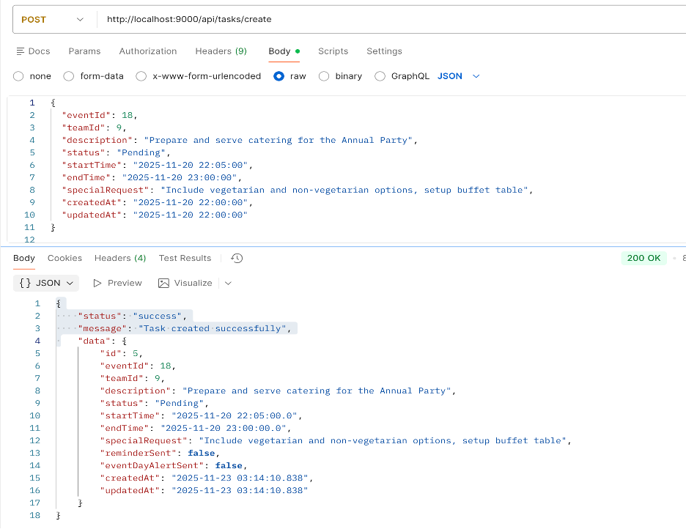
API & System Output
Operational Results
The system successfully handles end-to-end flows via secure REST Endpoints.
Task Creation: Verified API response with unique IDs.
Authentication: Secure JWT token generation.
Asynchronous Logs: Confirmed Kafka event consumption.

Slide 9





Security Implementation
JWT Authentication
Authorization (RBAC)
Data Encryption
Stateless authentication mechanism ensuring secure API access for the Event Manager.
Strict Role-Based Access Control. Only Managers can assign tasks; Vendors act on them.
All communication channels are secured via HTTPS to protect sensitive client and event data.

Slide 10
Thank You
Event Management Service Coordination System

